Slide 1

2019 Field Corn Weed Management Update
Eric P. Prostko
Professor/Extension Weed Specialist
Dept. Crop & Soil Sciences

Slide 2
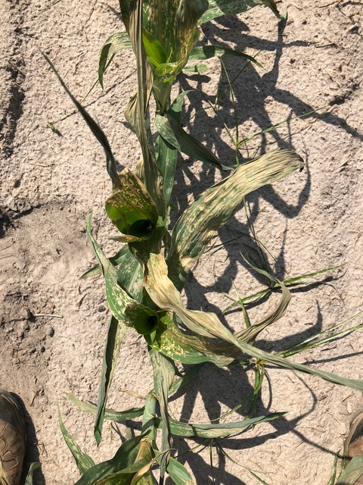
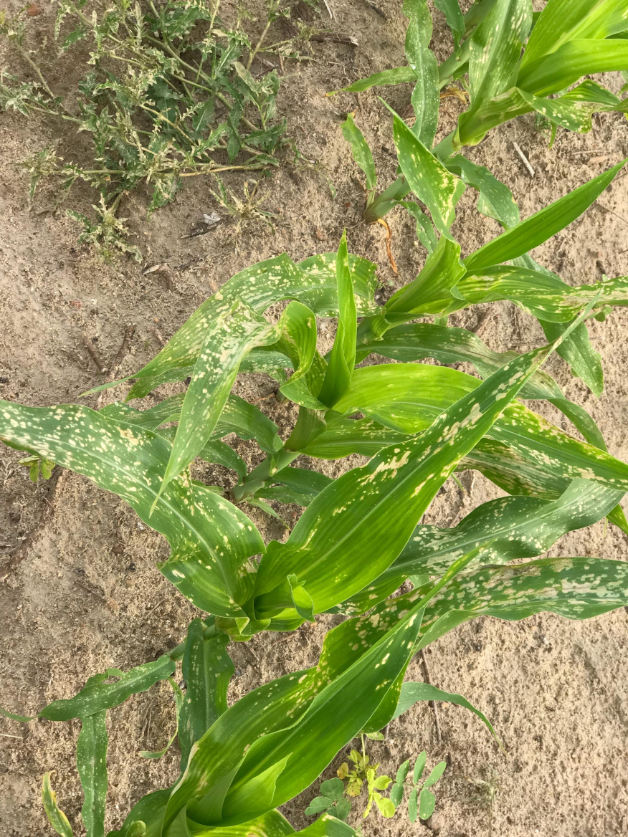
Valor Tank-Cleaning Problems - 2018

Slide 3
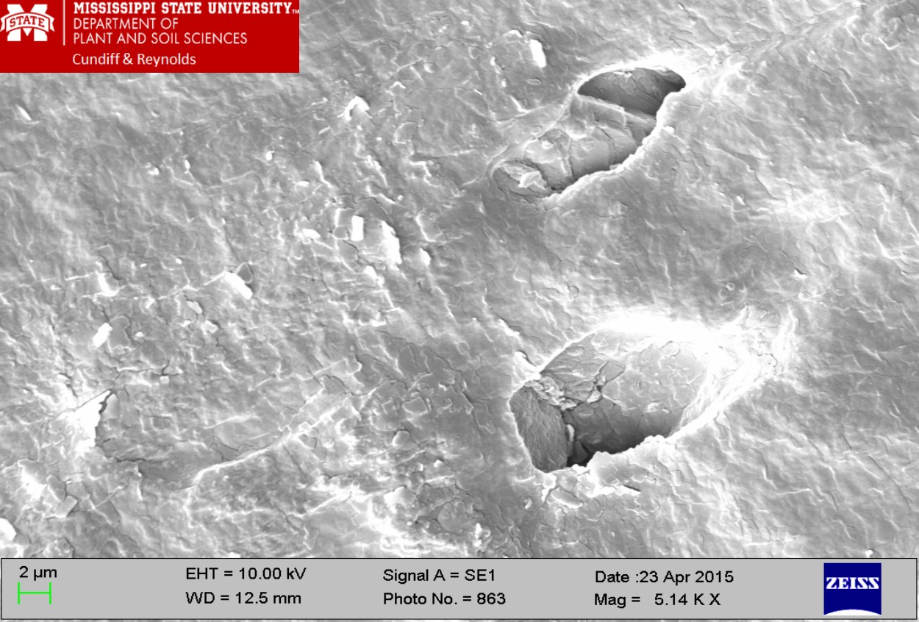
Scanning electron micrograph of a new Goodyear Hose (Black/Versigard Synthetic Rubber)

Slide 4
Field Corn (Pioneer 1794) Yield Response to Valor 51WG (oz/A) - 2015
CN-10-15
LSD 0.10 = 16
CV = 4

Slide 5
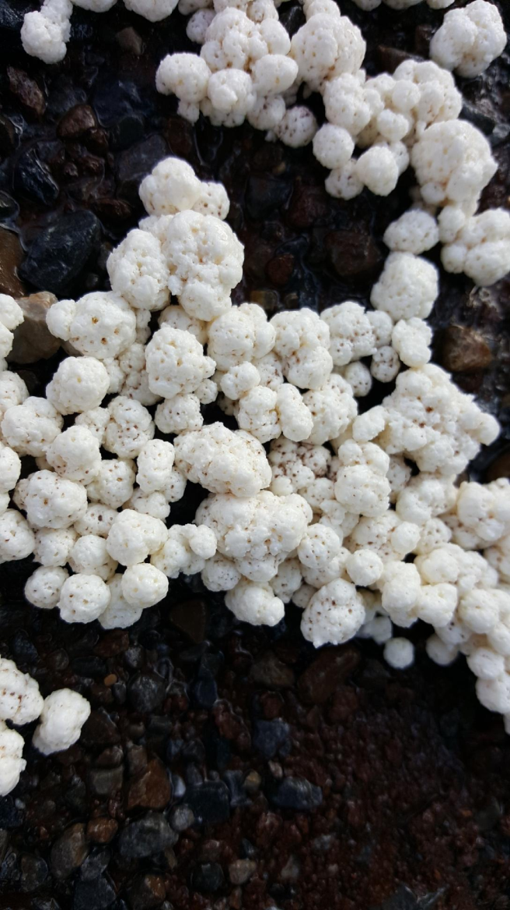
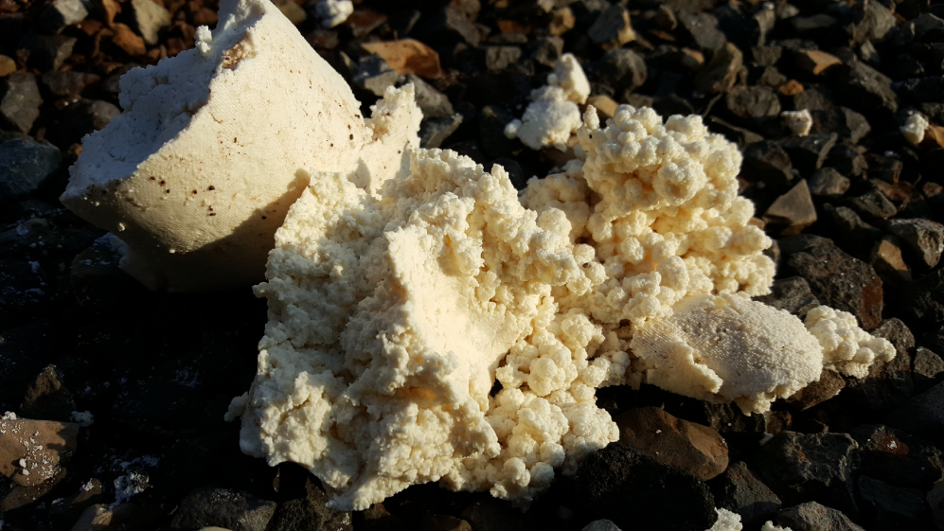
Halex GT Mixing Problems
May 9, 2018
Mixing Sequence Issue
  Atrazine + Halex GT + Interactive + FoamBuster
  Interactive should have been first
  10 GPA

Slide 6
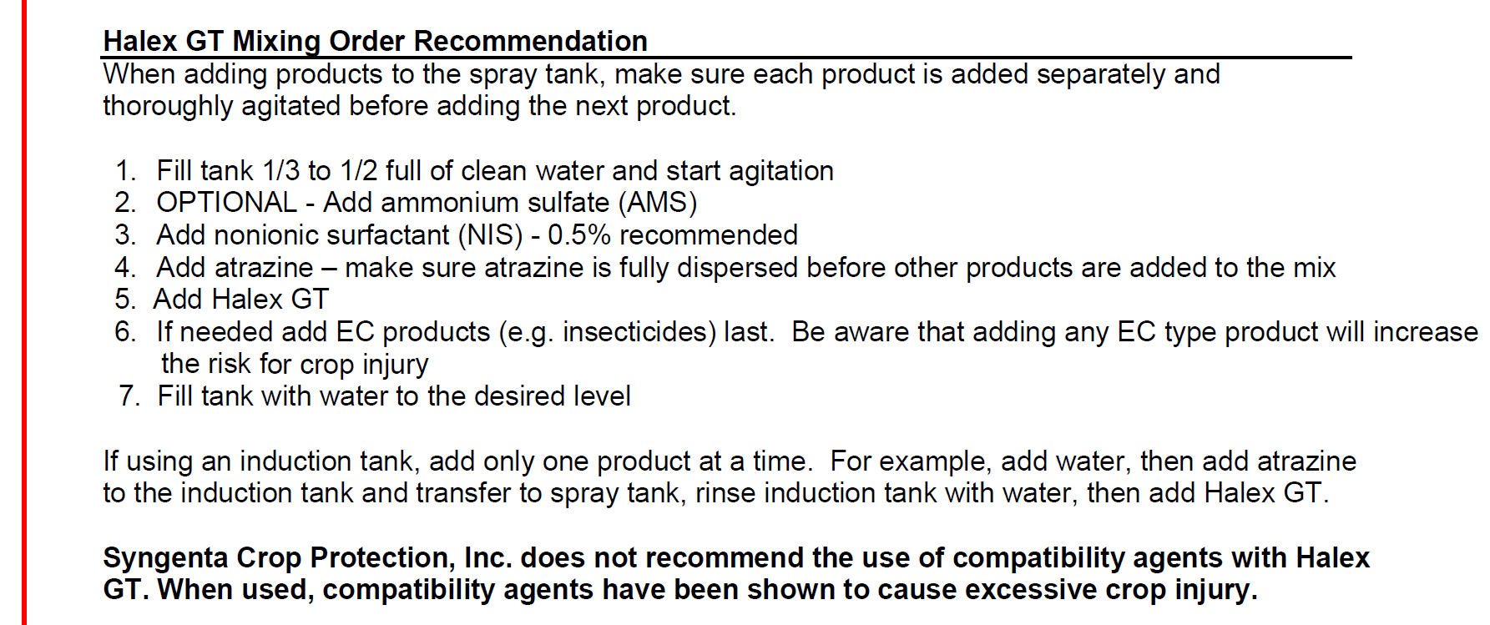
Halex GT Mixing Sequence

Slide 7
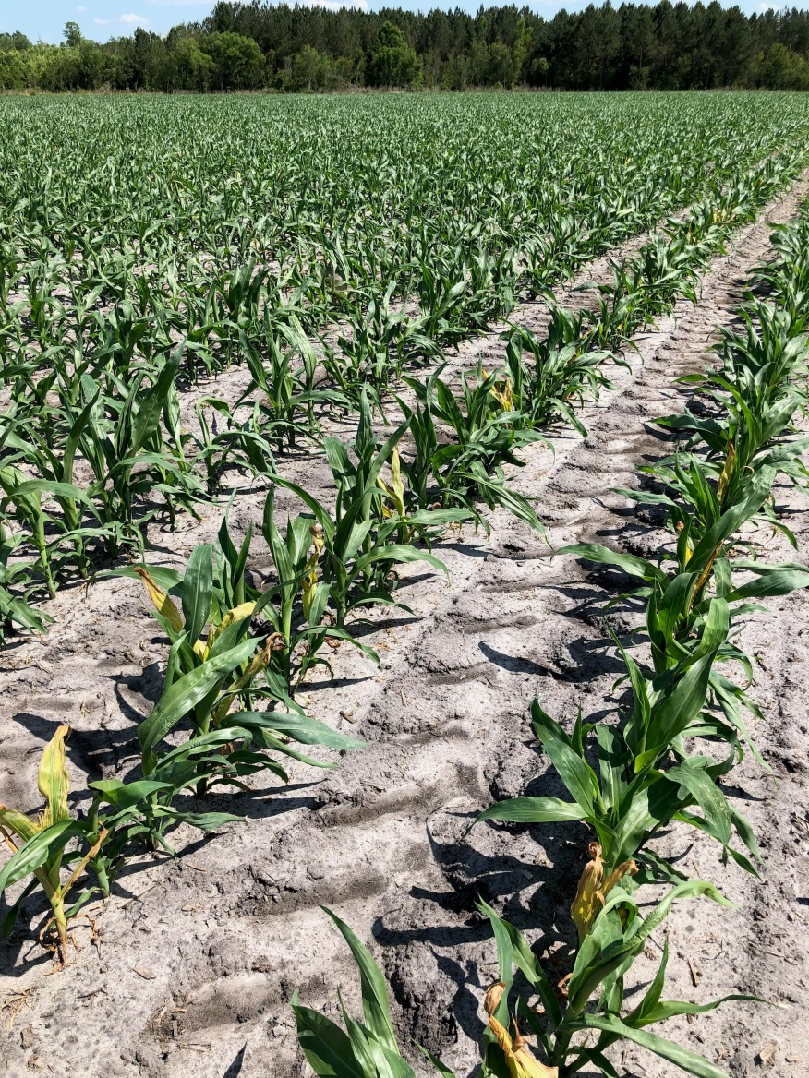
Liberty on DKC 6208
Not 100% trait purity in bag
Tolerance is ~4%?
Old hybrids = LL on male
New hybrids = LL on female

Slide 8
Field Corn Yield Loss (%) Caused by Uncontrolled Weeds in UGA Weed Science Research Trials (2007-2018).
Treated vs. Non-treated
200 Bu/A X 0.35 X $3.59 = $251/A

Slide 9
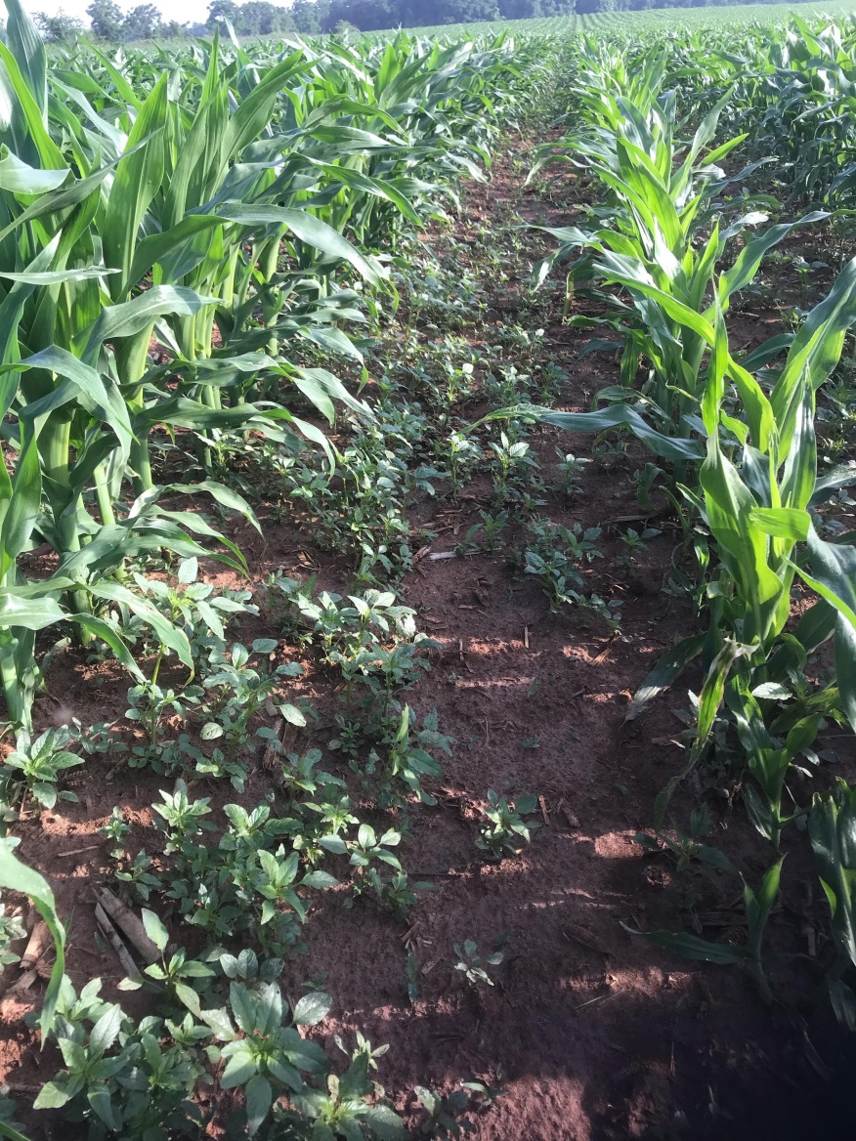
Is Roundup + Atrazine good enough anymore?
Roundup + Atrazine +.
  Laudis
  Capreno (?)
    Too hot for GA
  Impact Z
  Status (dicamba)
  + Prowl too?
  Counter INFR, Crop Rotations???? \
    Double-crop soybeans
Other options?
  Liberty, Halex GT, Revulin Q, Enlist????

Slide 10
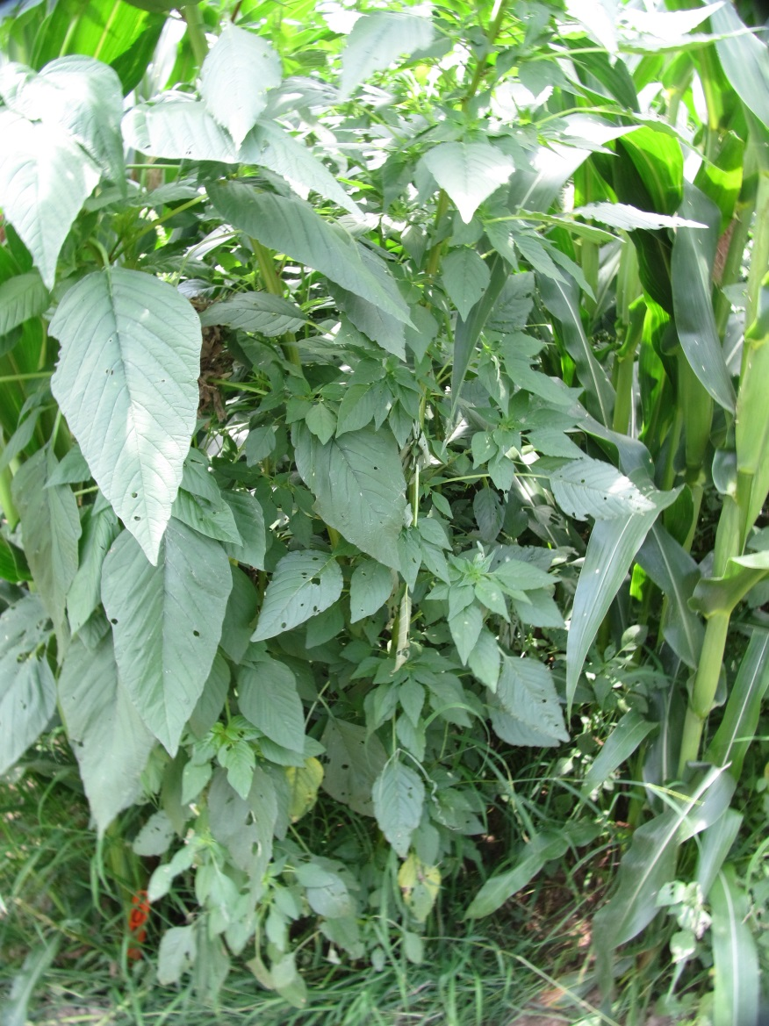
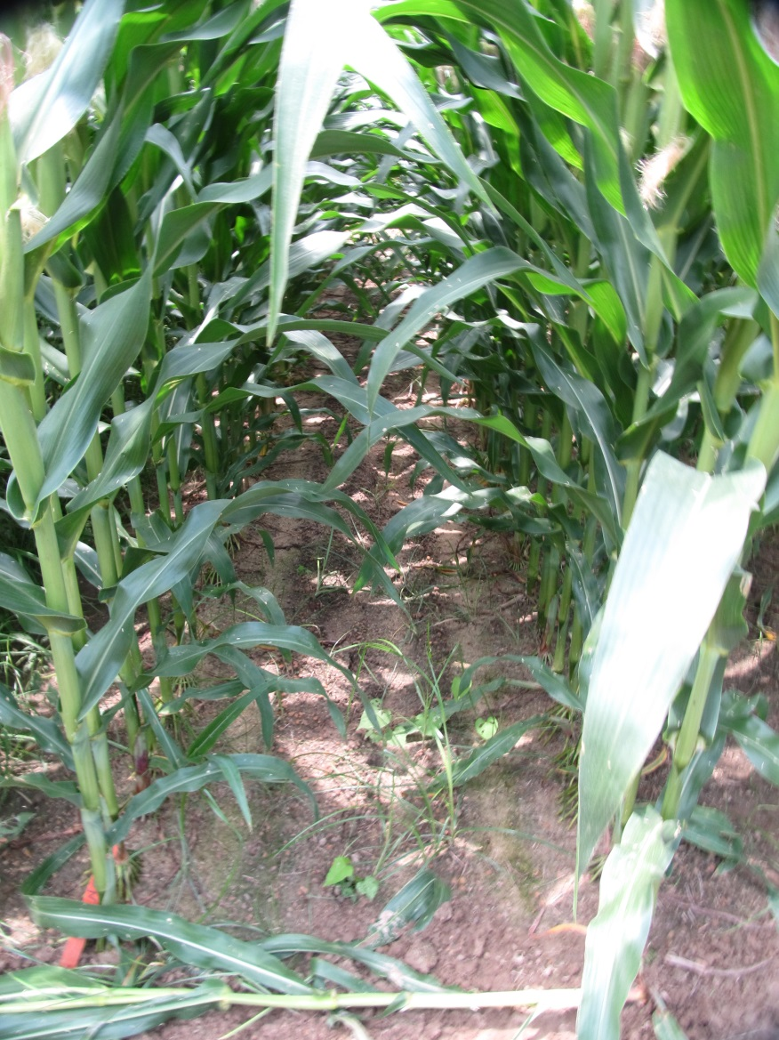
Roundup + Atrazine + Prowl - 2018
NTC
Roundup Powermax 5.5SL @ 32 oz/A
Atrazine 4L @ 64 oz/A
Prowl H₂0 3.8SC @ 32 oz/A
Applied 21 DAP
CN-12-18
June 6
70 DAP

Slide 11
Roundup (R) + Atrazine (A) + Prowl (P) Effects on Field Corn Yield (16 trials)
NTC = non-treated check (weedy)

Slide 12
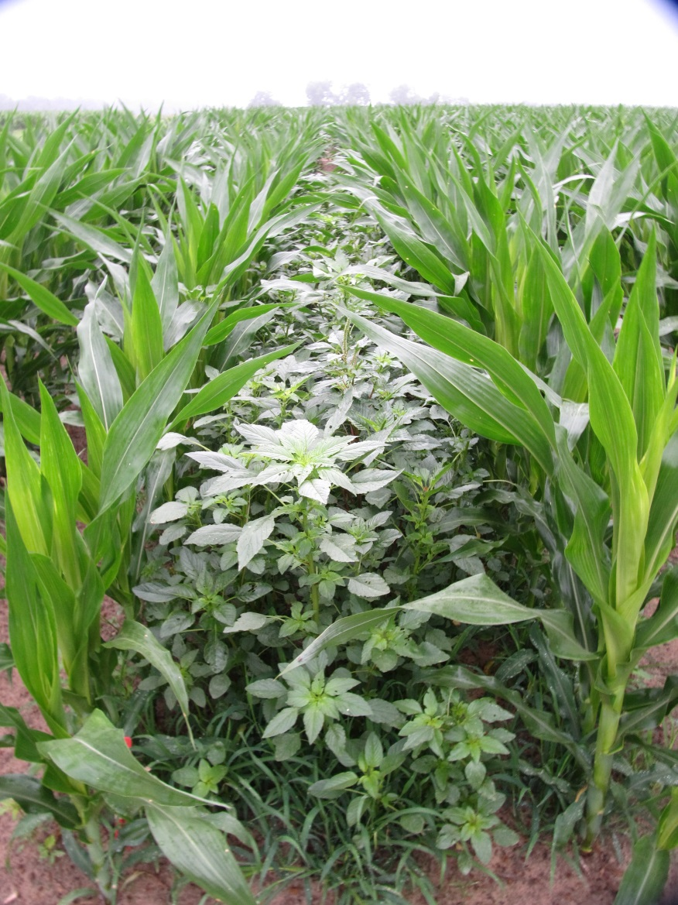

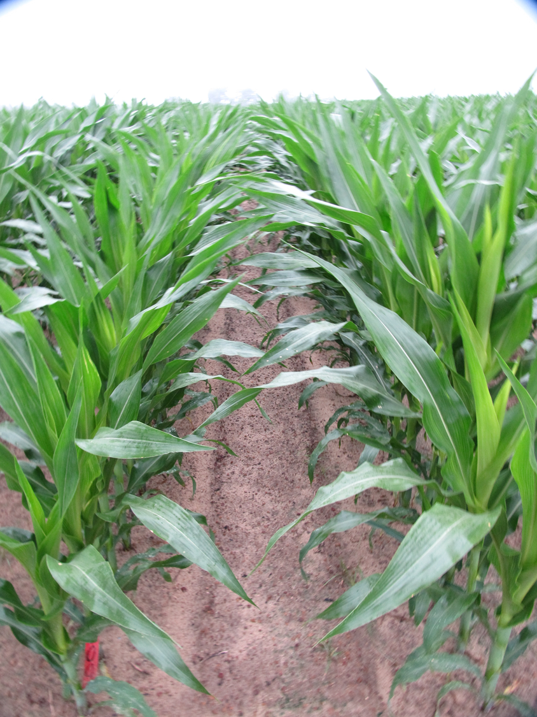
Roundup + Atrazine + Laudis - 2018
CN-06-18
May 16
22 DAT
NTC
Roundup PowerMax 5.5SL @ 32 oz/A (28 DAP)
Atrazine 4L @ 64 oz/A (28 DAP)
Laudis 3.5SC @ 3 oz/A (28 DAP)

Slide 13
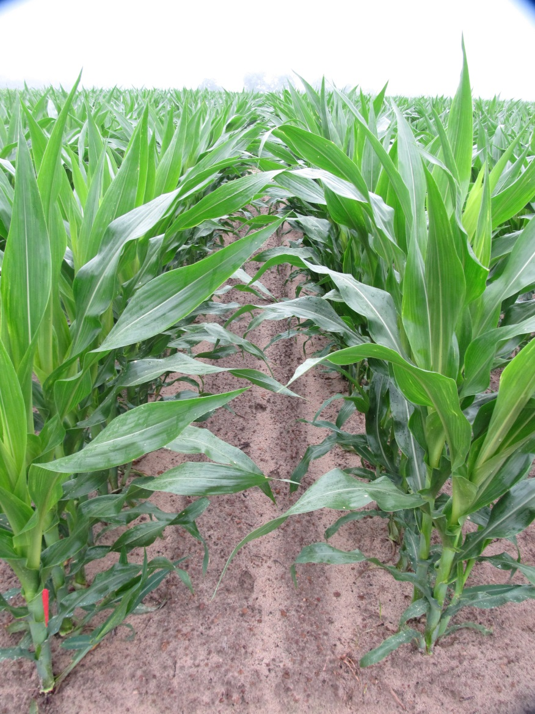

Field Corn Weed Control - 2018
NTC
Liberty @ 29 oz/A
Atrazine @ 64 oz/A
Prowl H₂0 @ 32 oz/A
(Applied 28 DAP)
CN-06-18
May 16
22 DAT

Slide 14

Impact/Impact Z/Armezon
POST
AMVAC, BASF
Topramezone
HPPD
Need to tank-mix with something
Impact Z
  Includes ATZ
    4 lbs/gal

Slide 15
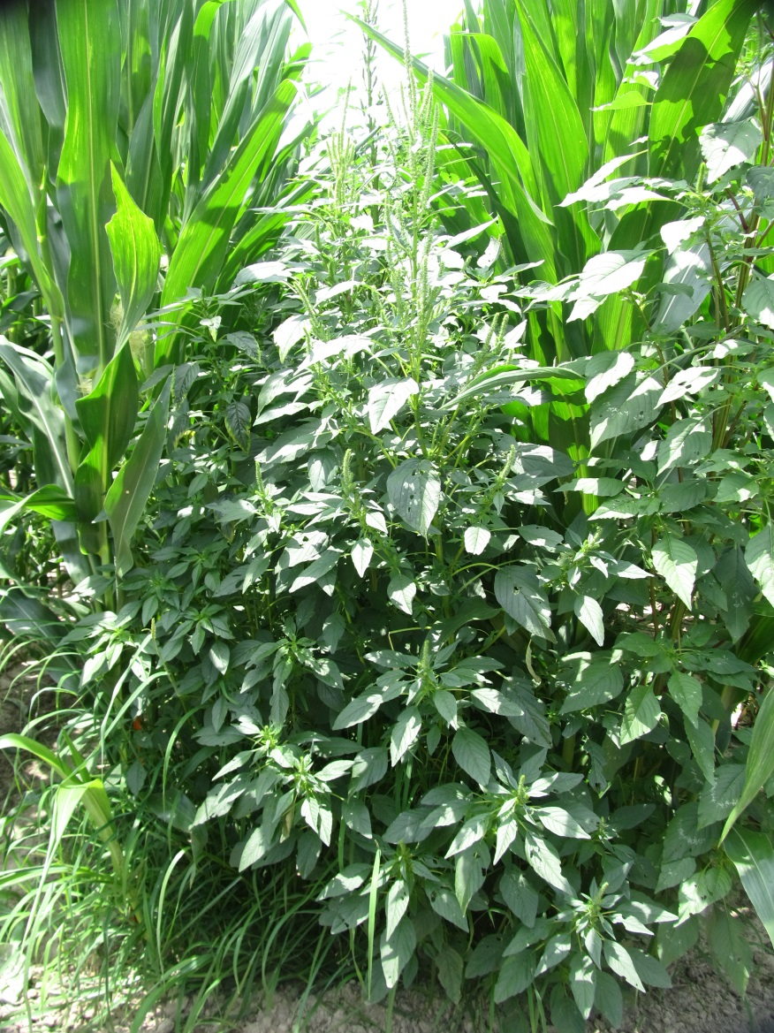
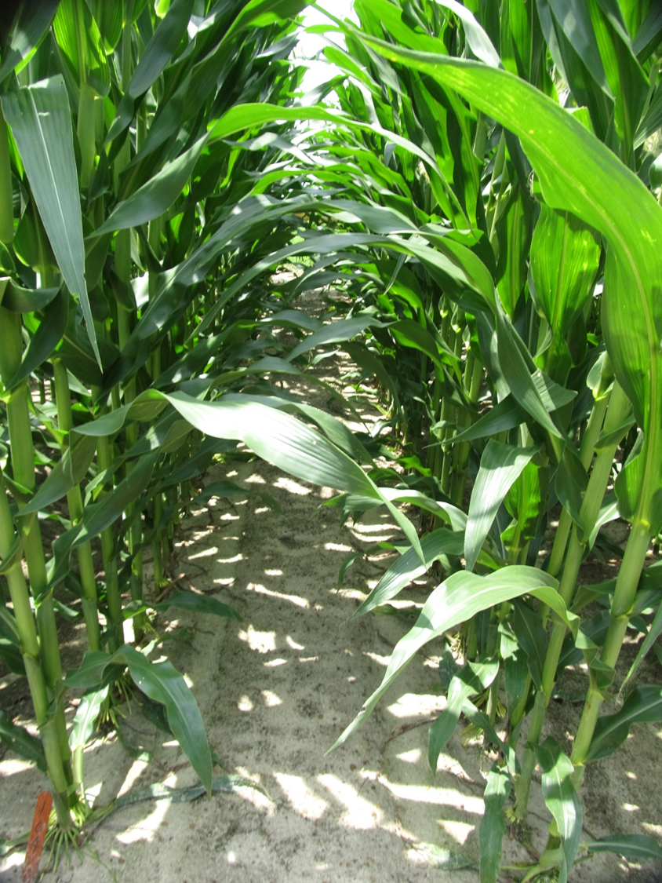
Impact Z - 2018
Roundup P-MAX @ 32 oz/A
Impact Z @ 8 oz/A
Prowl H₂0 @ 32 oz/A
Applied 28 DAP
NTC
CN-17-18
June 6
65 DAP

Slide 16

Halex GT
Syngenta
POST
  58 oz/A
glyphosate + s-metolachlor + mesotrione
Tank-mix with ATZ
Will cause bleaching and buggy whipping
  rate
  weather
Tank-mix order is important

Slide 17
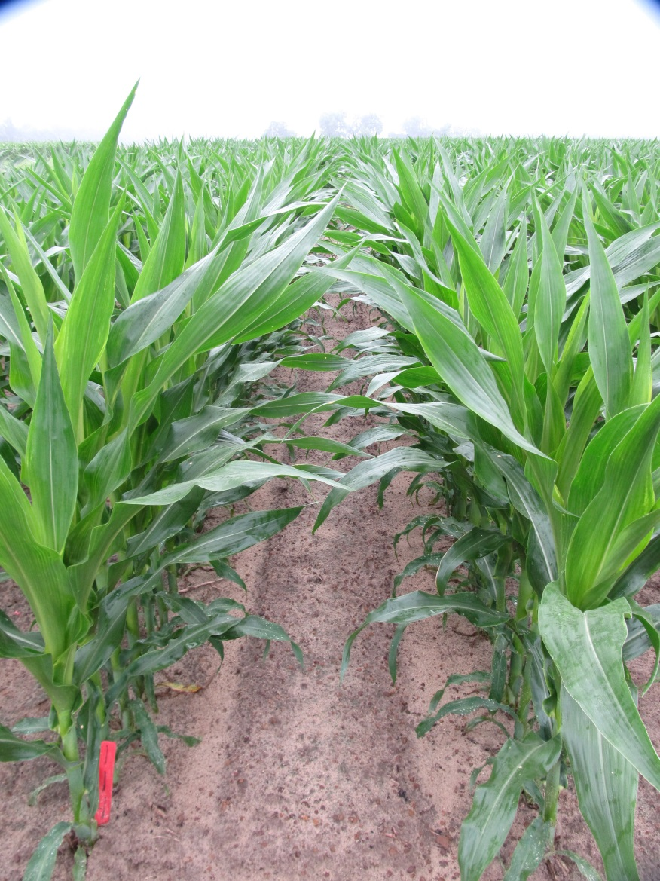
Halex GT - 2018
NTC
Halex GT @ 58 oz/A
Atrazine 4L @ 64 oz/A
NIS @ 0.25% v/v
Applied 28 DAP
CN-06-18
May 16
40 DAP

Slide 18
Roundup (R) + Atrazine (A) + Prowl (P) vs. Halex GT (HGT) + Atrazine – Corn Yields
NTC = non-treated check (weedy)

Slide 19
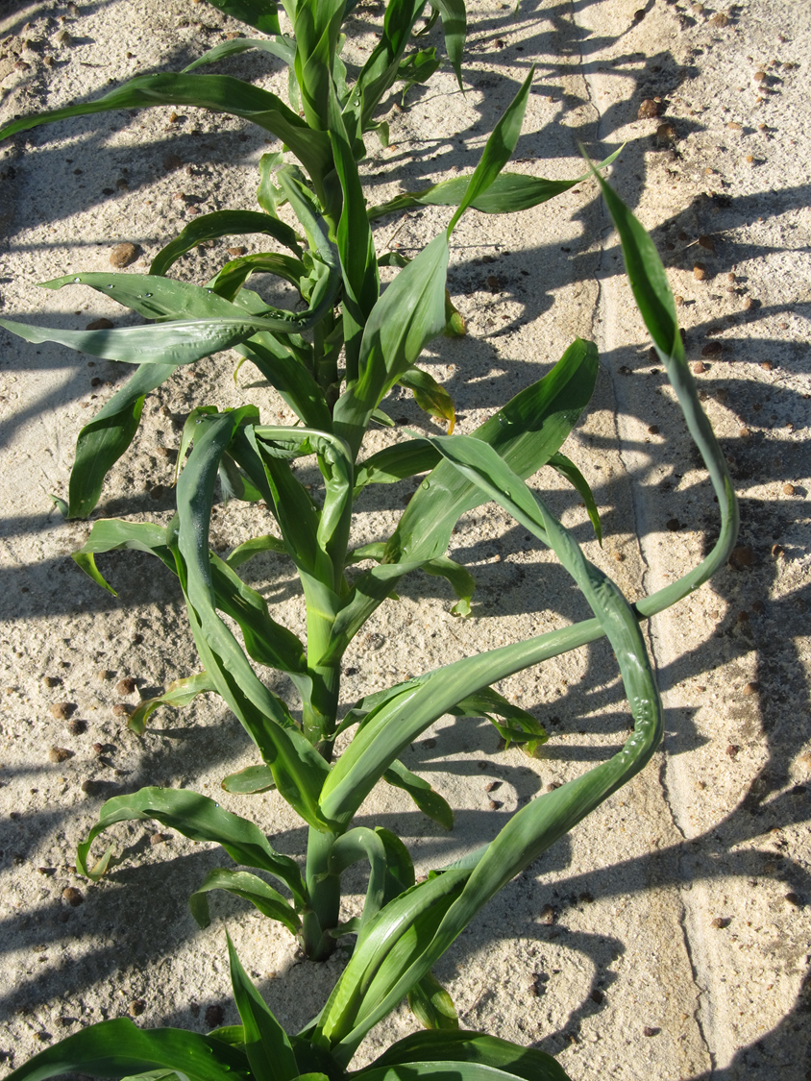
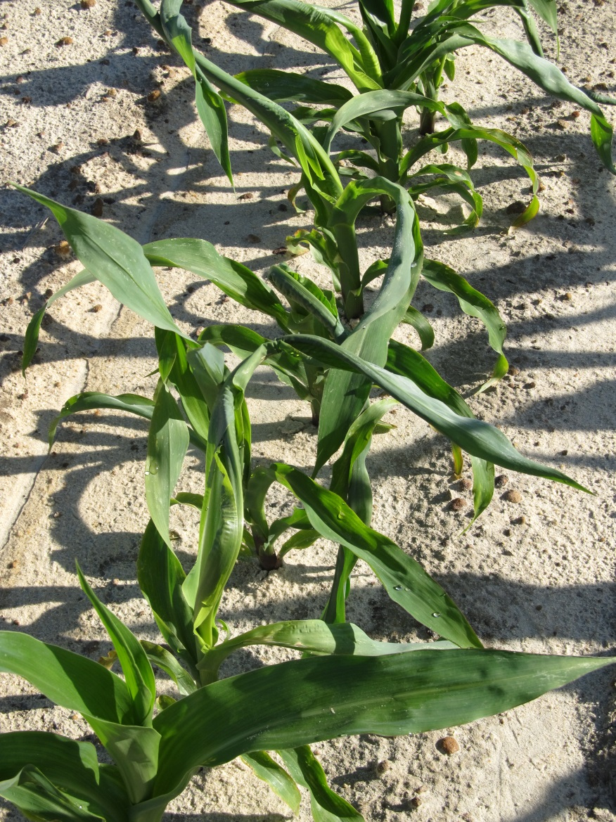
Halex GT (1X) + Atrazine + Induce
Applied V2 Stage – 15 DAP
CN-04-18
May 2
21 DAT
Pioneer 1870YHR

Slide 20
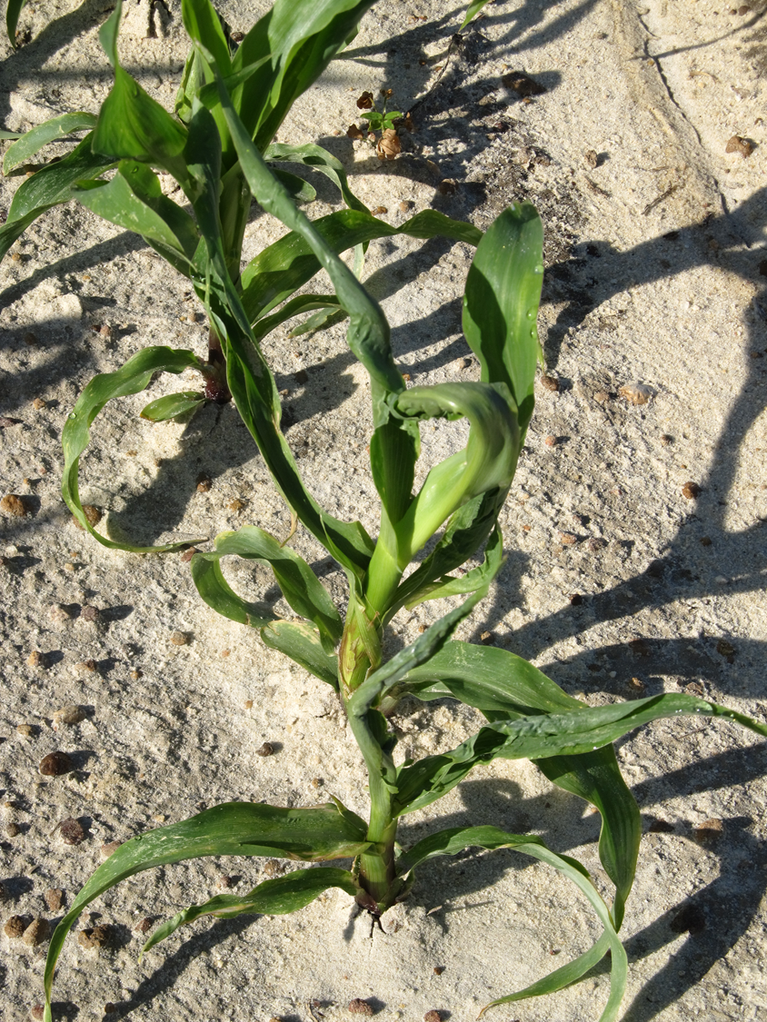
Halex GT (2X) + Atrazine + Induce
Applied V2 Stage – 15 DAP
CN-04-18
May 2
21 DAT
Pioneer 1870YHR

Slide 21
Halex GT (HGT) Effects on Field Corn Yield - 2018
HSD (P = 0.10) = 56
CV = 12.3
CN-04-18
P1870YHR

Slide 22
ALS Herbicide Carryover to Field Corn? (Cadre, Staple, Strongarm)
usually not a problem in GA due to high rainfall/irrigation and sandy/low OM soils
  Herbicide differences?
  Hybrid differences?
follow label restrictions
Carryover looks like nematode damage or fertility issues

Slide 23
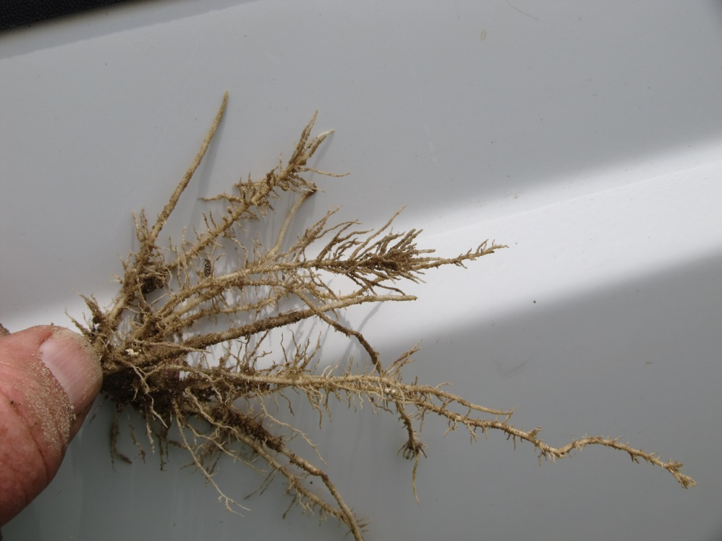
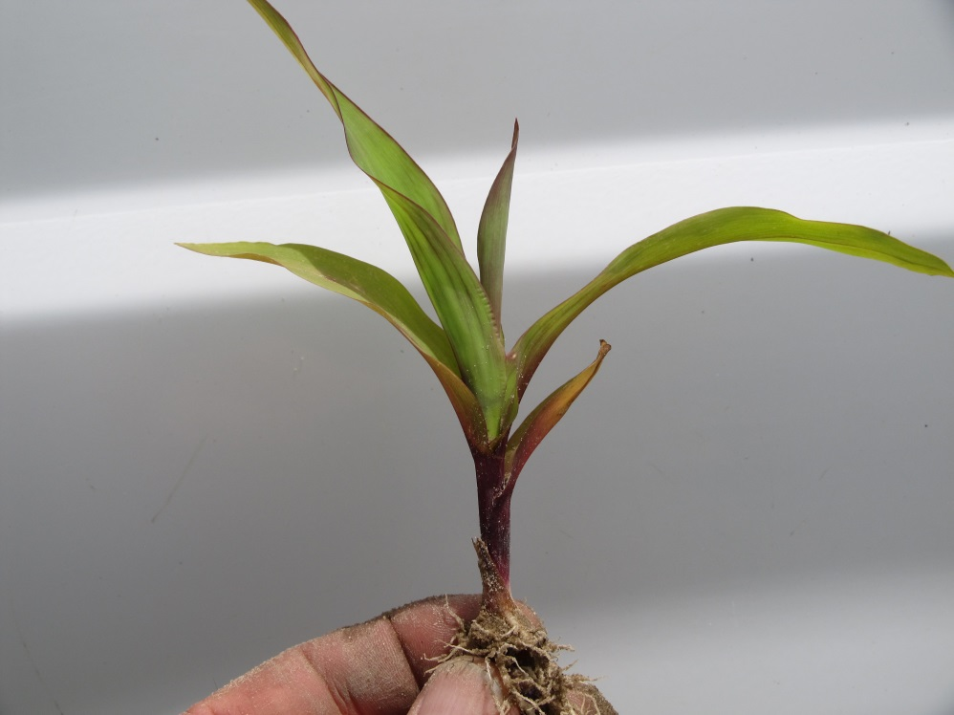
Staple LX @ 1/4X – Pioneer 1739 YHR
CN-01-18
April 23
26 DAT

Slide 24
Field Corn Hybrid Yield Response to Soil Applied ALS Herbicides - 2018
THSD (P=0.10) = 36
CN-01-18
August 28

Slide 25
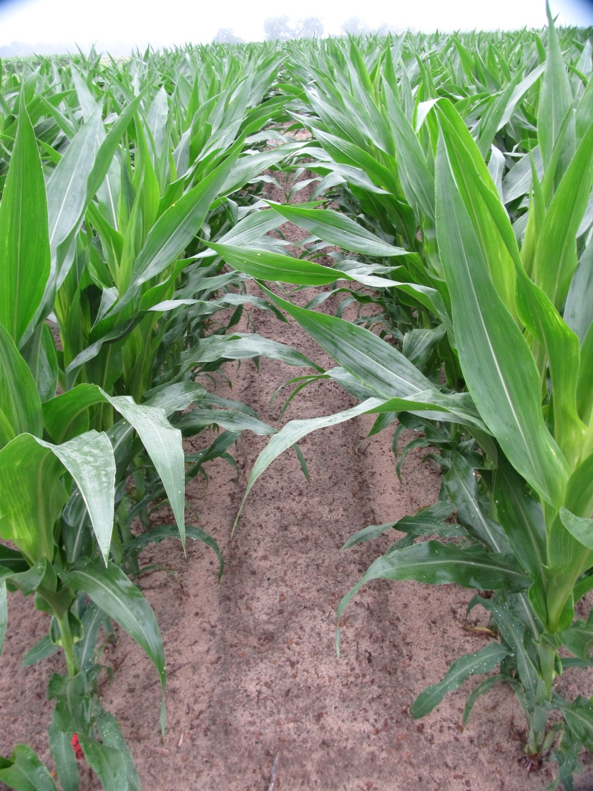
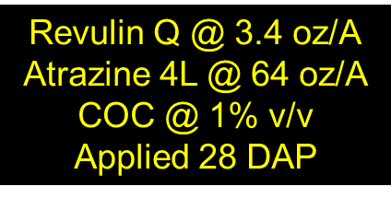
Revulin Q – 2018
(Accent + Callisto)
NTC
CN-06-18
May 16
40 DAP

Slide 26
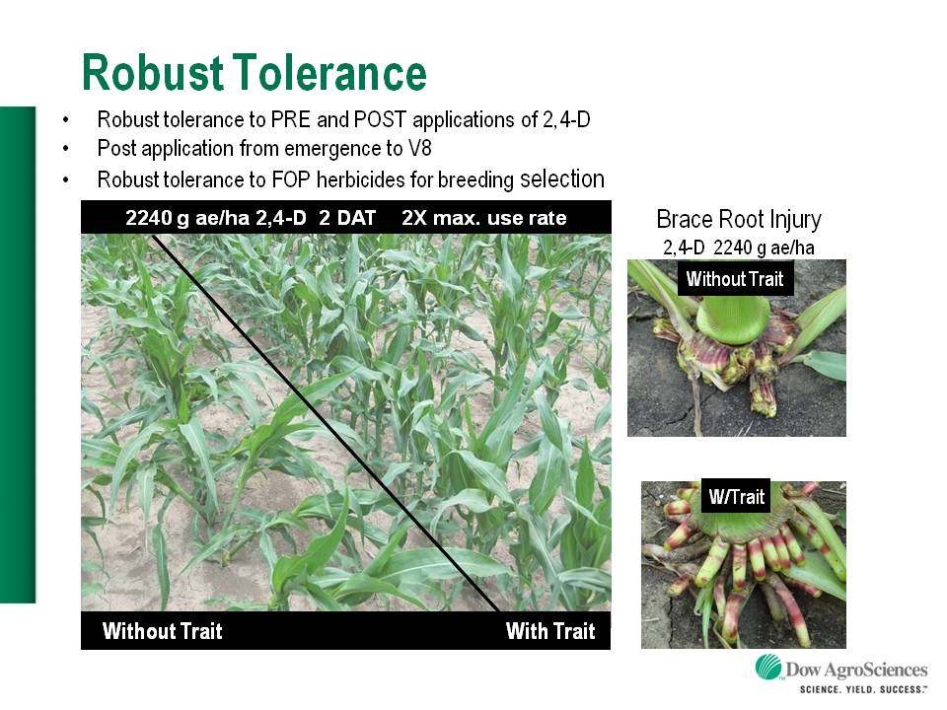

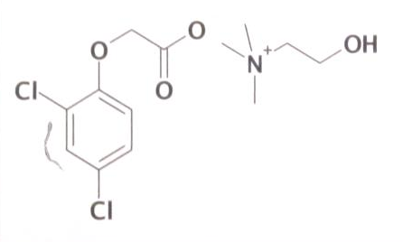

Enlist™ Herbicide Tolerant Corn
tolerance to 2,4-D and Assure + GLY
Trait was deregulated in September 2014 and herbicide in October 2014. U.S. launch in 2018 (SE??).
Colex-D™ technology
  2,4-D choline
  lower volatility
  lower drift potential
  enhanced handling/mixing characteristics
  reduced odor
1 PRE application + 2 POST applications (30” or V8 stage)
Enlist™ Duo
  DMA-Glyphosate (1.71 lb ae/gal) + 2,4-D choline (1.63 lb ae/gal)
Enlist™ One
  2,4-D choline (3.8 lb ae/gal)
2,4-D choline

Slide 27
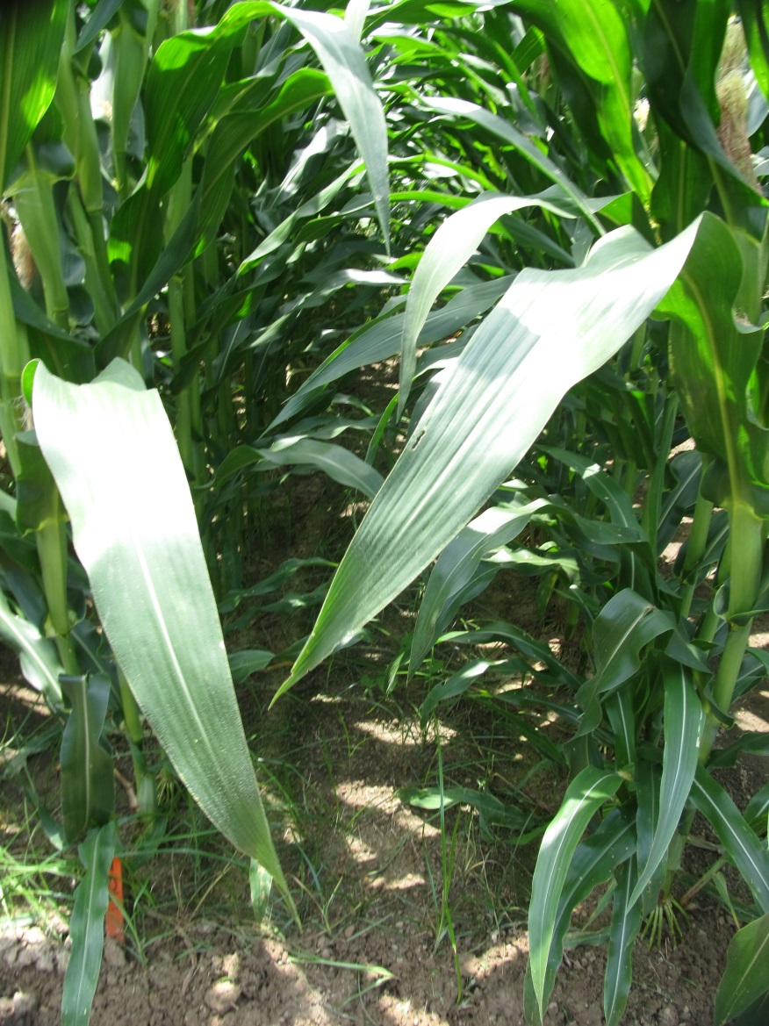
Field Corn Weed Control – 2018
Enlist System (Hybrid: MY13C99 - 217 Bu/A)
NTC
Enlist One 3.8SL @ 24 oz/A
Roundup P-Max 5.5SL @ 32 oz/A
Prowl H₂O 3.8SC @ 32 oz/A
Applied 21 DAP
CN-12-18
June 6
50 DAT

Slide 28
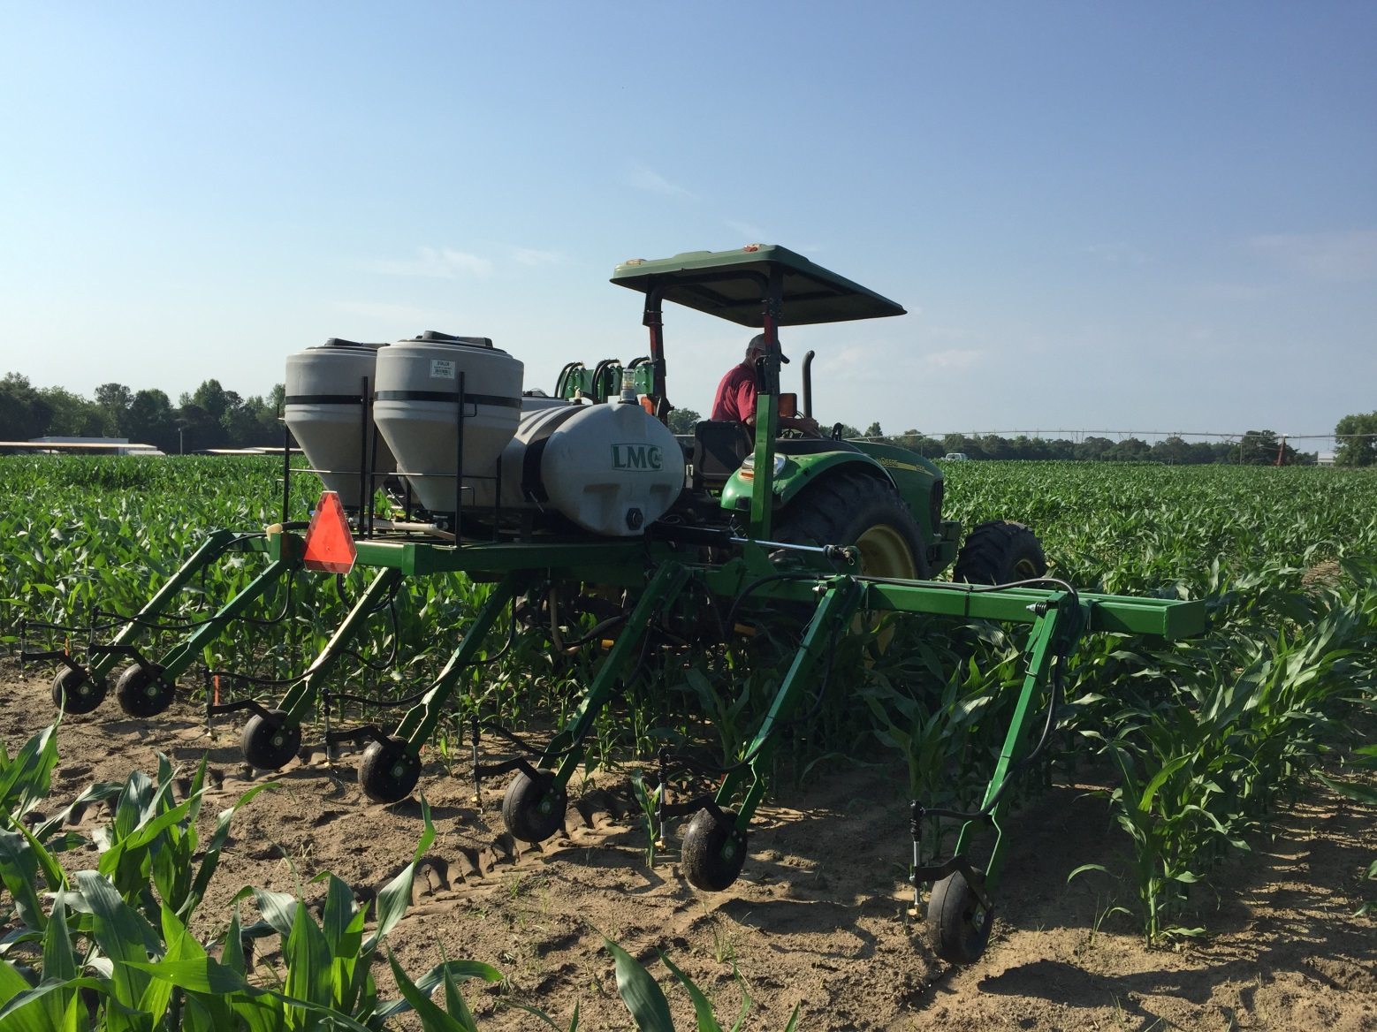
Field Corn Lay-By
(16 GPA, 30 PSI, 3.7 MPH, Floodjet TK-VS2)

Slide 29
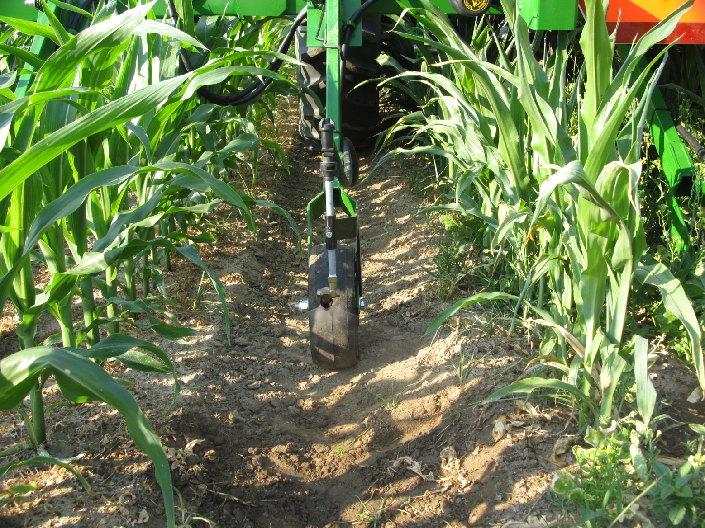
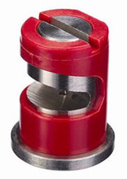
Field Corn Lay-By

Slide 30
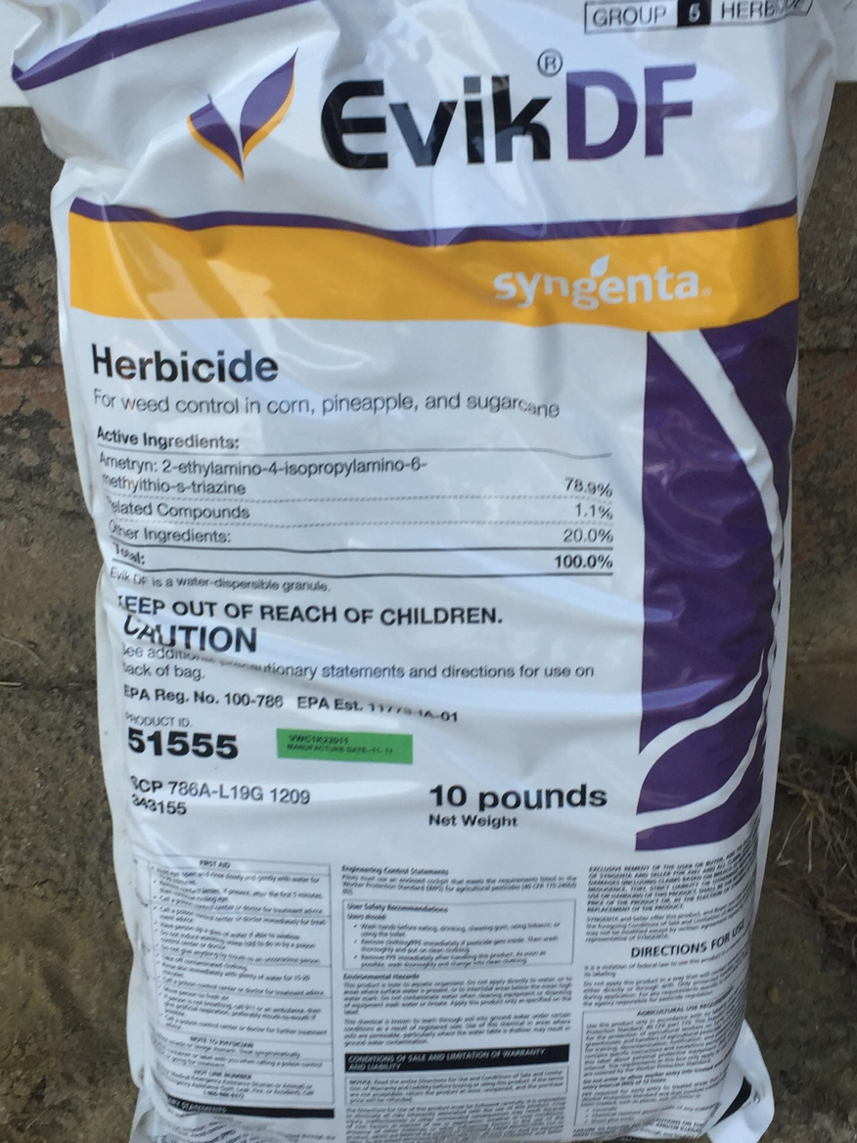
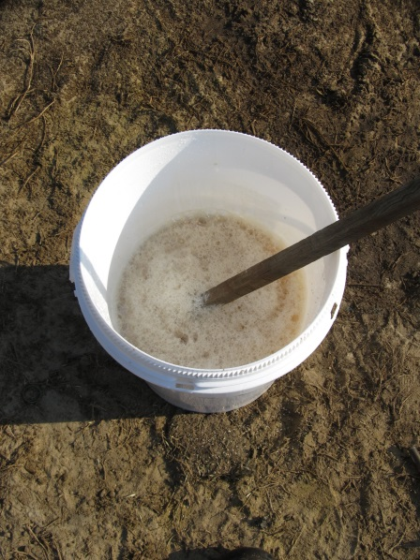
Great Herbicide but Crappy Formulation!
Product age
20 GPA
Pre-slurry
STRONG agitation

Slide 31
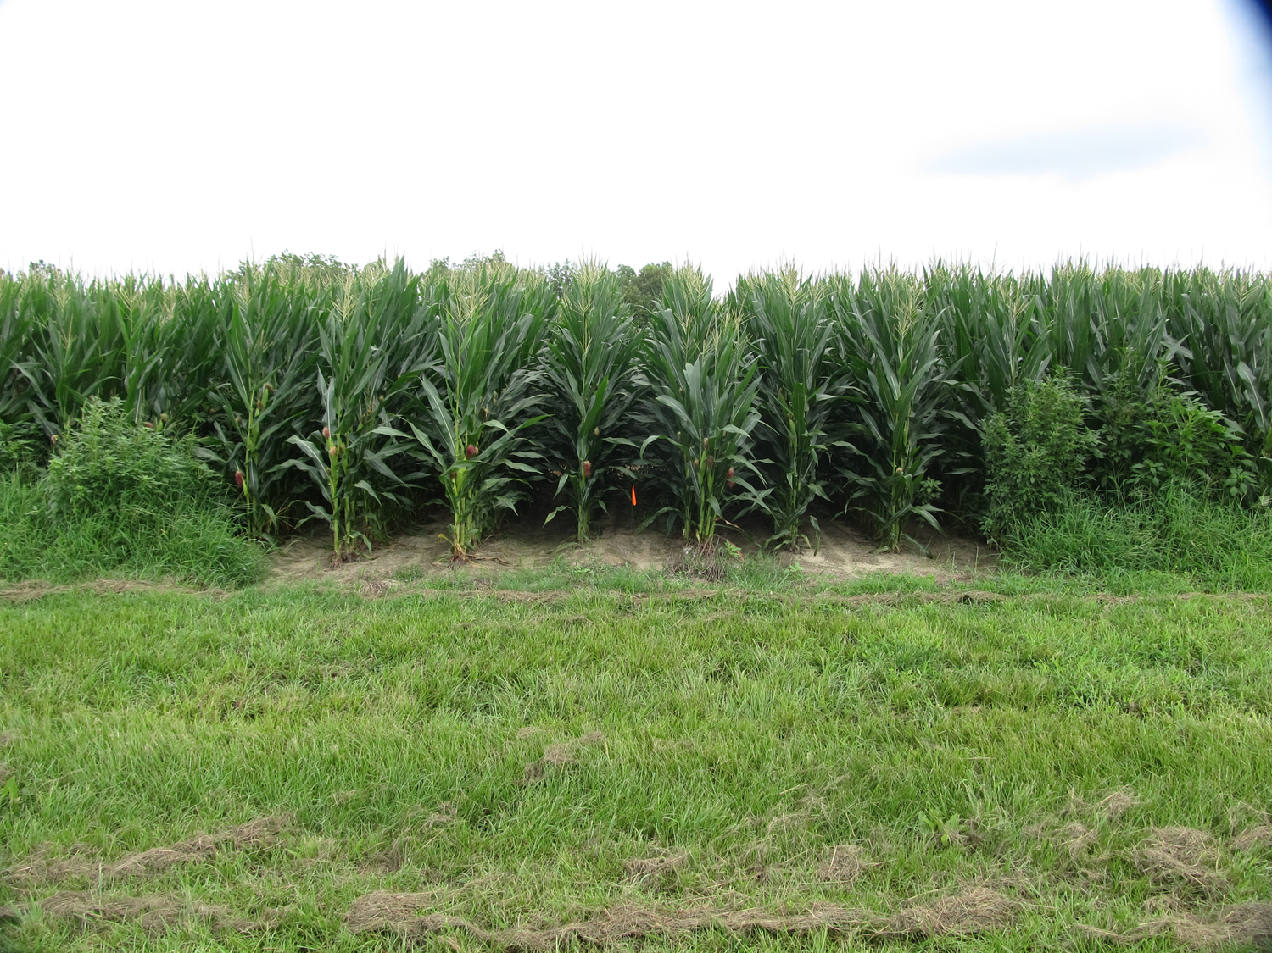
Roundup Powermax II @ 32 oz/A + Evik 80DF @ 2 lbs/A – 36 DAT (June 15)
NTC
7 row middles
Treated
NTC
16 GPA
30 PSI
3.7 MPH
V7-V8
24” tall
FloodJet
TK-VS2
NTC
TREATED

Slide 32
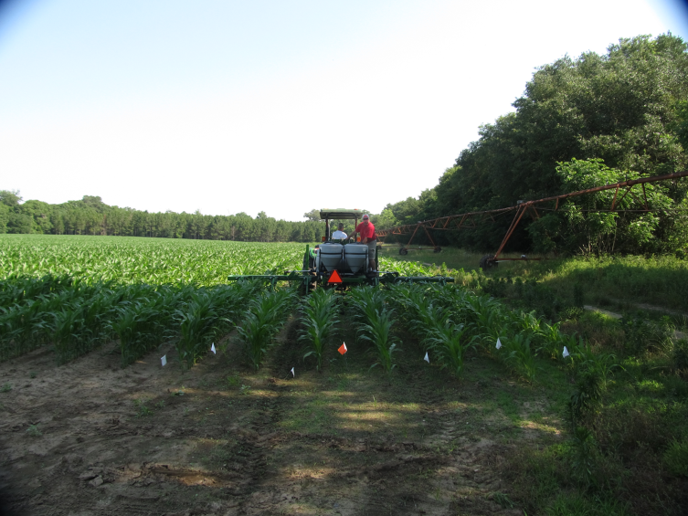
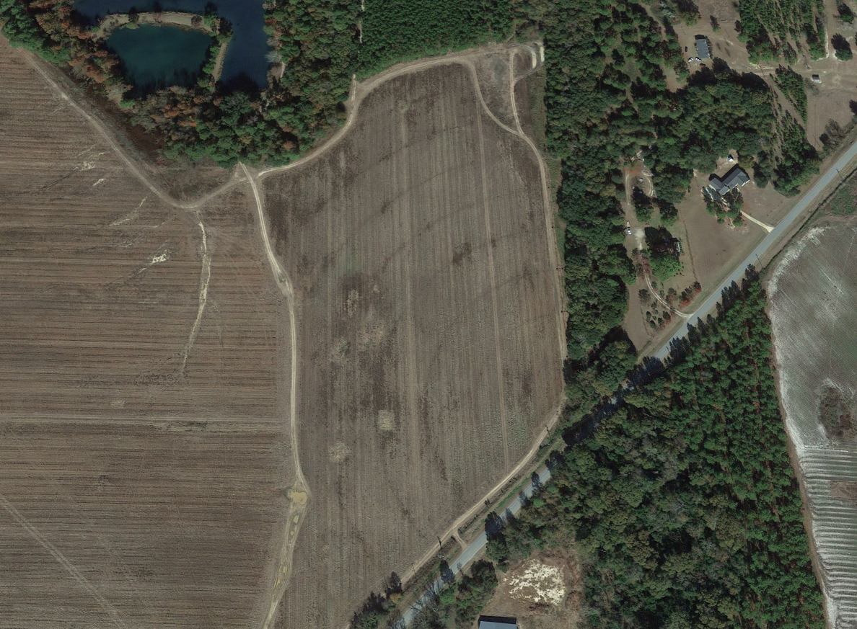
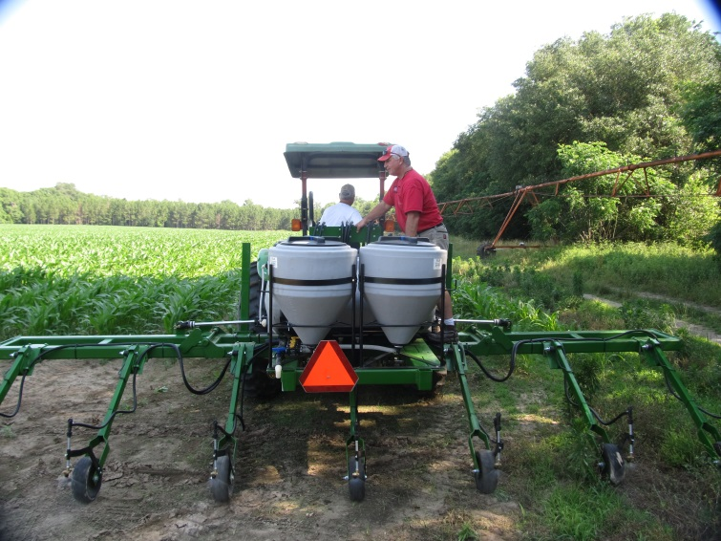
Field Corn Lay-By Test
Mitchell Co. – May 11, 2018

Slide 33
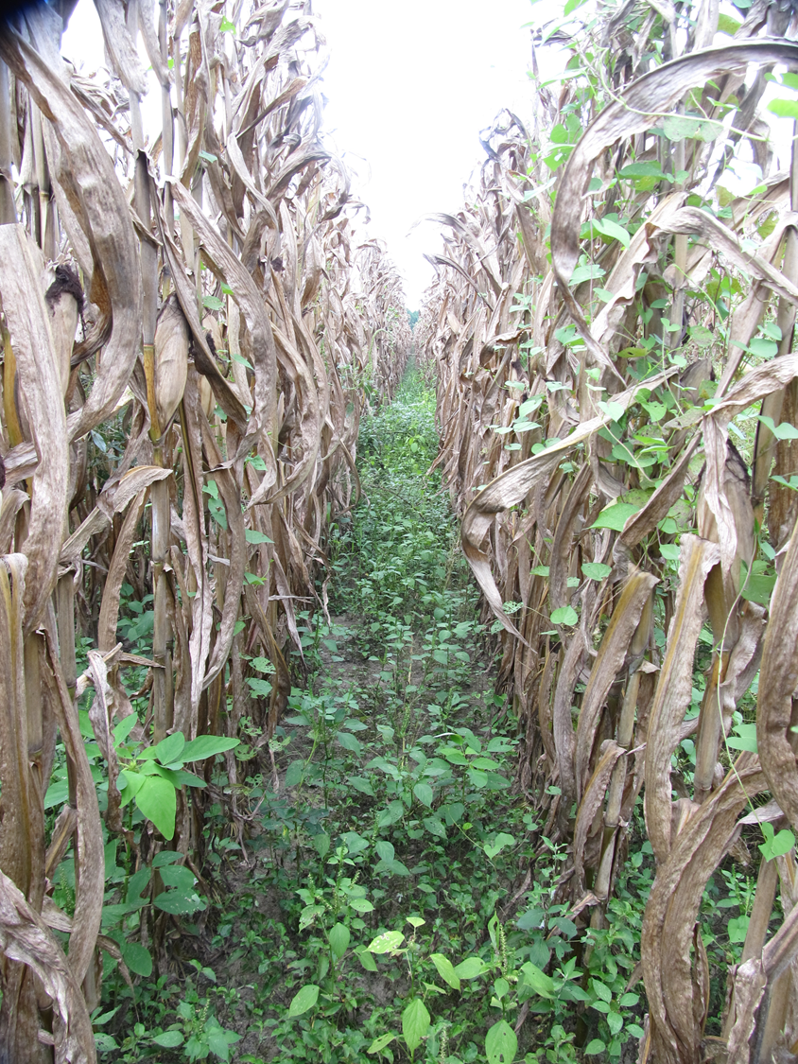
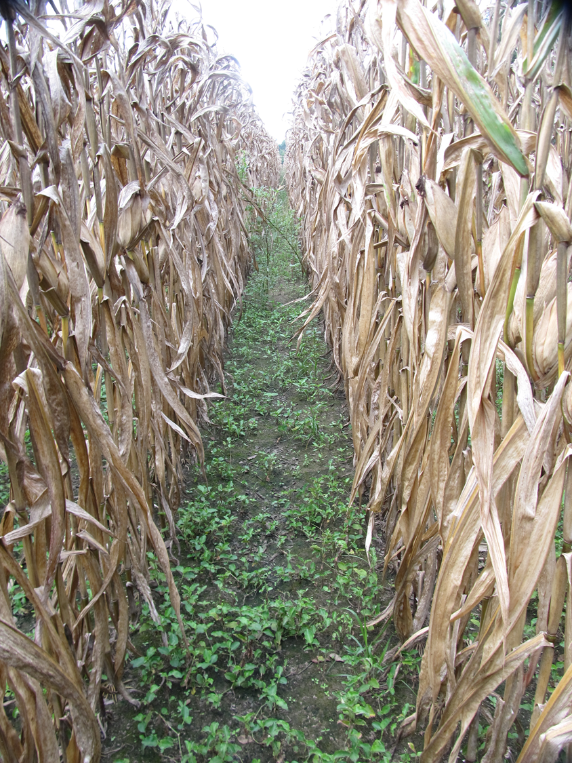
Mitchell County Corn Lay-By
August 15, 2018 (96 DAT)
Laudis @ 3 oz/A
Broadcast
Roundup P-Max @ 22 oz/A
Laudis @ 3 oz/A
Post-Directed

Slide 34
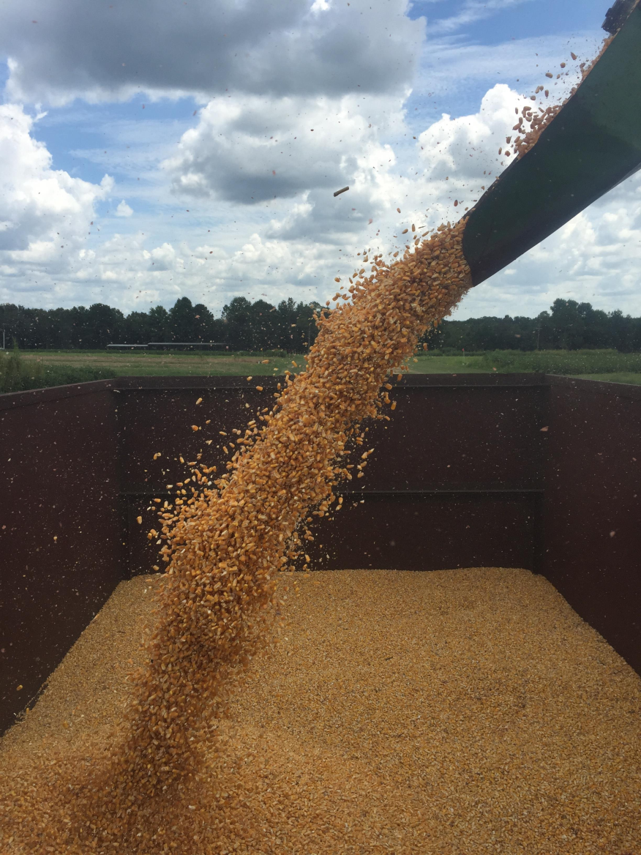
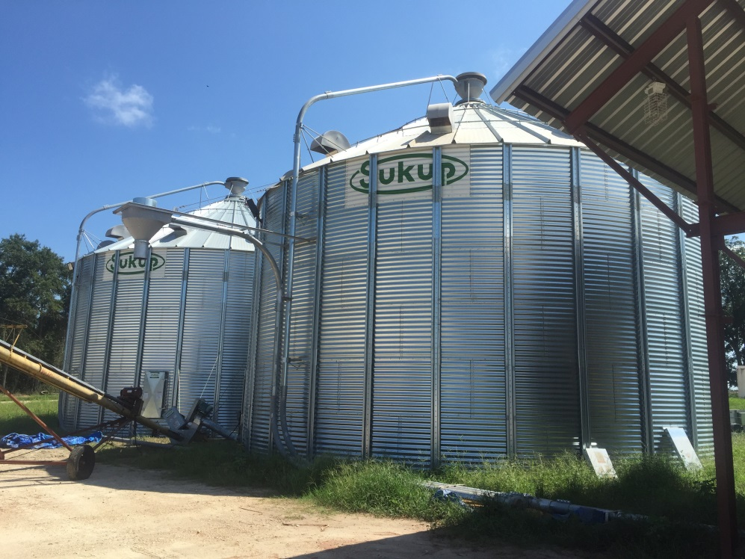
Questions/Comments?

